Slide 1
AI Pipeline for Image Object Detection and Segmentation
Author: Faraz Ahmed Siddiqui
Date: September 25, 2024

Slide 2
Project Overview
A Streamlit application that enables users to upload images for object detection and segmentation.
Utilizes pre-trained Mask R-CNN and Faster R-CNN models.
Displays detected objects along with summaries of attributes.

Slide 3
Key Features
Image Upload: Supports JPG and PNG formats.
Object Detection: Detects objects using Mask R-CNN.
Segmentation: Extracts detected objects as separate images.
Attribute Summarization: Summarizes extracted text using transformer models.
User-Friendly Interface: Intuitive interaction with Streamlit.

Slide 4
Installation & Running
Python 3.8 or higher
Install Dependencies: streamlit torch torchvision easyocr transformers opencv-python (use requirements.txt file for the same)
Creating Environment: Creating a virtual environment
Run the App: streamlit run app.py (replace app.py with actual file name in streamlit_app directory)

Slide 5

Input Images

Slide 6
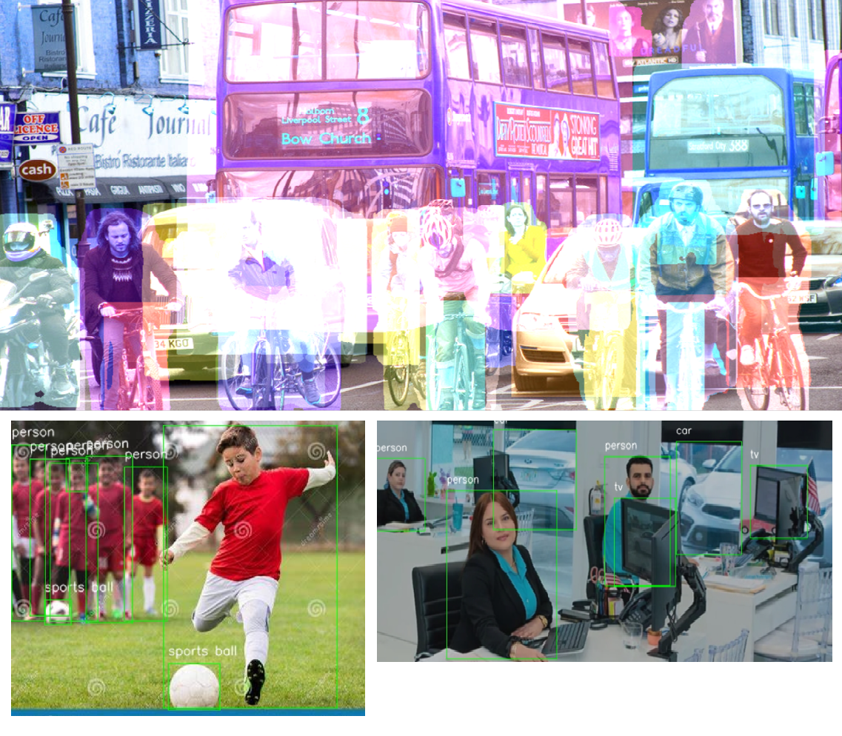
Outputs

Slide 7
Usage
Upload an image (.jpg/.jpeg/.png).
View the image with detected objects and summaries.
See extracted objects with their text summaries.

Slide 8
Image Processing Functions
Process image: Converts uploaded image to tensor.
Segment and extract objects: Segments image and returns masks.
Draw boxes: Draws bounding boxes around detected objects.
Identify and extract text: Extracts and summarizes text.

Slide 9
Future Enhancements
Alternative Approaches: Improving efficiency for object detection labeling
Enhanced Text Extraction: Use more robust techniques.
User Customization: Modify detection thresholds.

Slide 10
Credits
Mask R-CNN by Facebook AI Research
EasyOCR by Jaided AI
Streamlit framework
Thank you..

